Slide 1
Zoning/Housing
Contextual Data
Meeting 1: June 11, 2025

Slide 2
Wellesley Zoning Districts
Single Residence Districts
SR10
SR15
SR20
SR30
SR40
SRA
Other Residence Districts
General Residence
General Residence A
Town House
Multi-Unit Residence
Limited Residence
Limited Apartment
Commercial Districts
Business
Business A
Industrial
Industrial A
Limited Business
Admin & Professional
Special Use Districts
Educational
Educational A
Educational B
Transportation
Parks, Rec & Conservation
Other Special Districts
Wellesley Square Commercial
Lower Falls Village Commercial
Planned Development
Overlay Districts
Historic
RIO
Linden St Corridor
Large-Scale Solar
Commercial Recreation
Wellesley Park Smart Growth
Flood Plain / Watershed Protection
Water Supply Protection

Slide 3
Wellesley Zoning District Sizes
District | % of Town Area
SR10 | 21.6%
SR15 | 10.5%
SR20 | 24.7%
SR30 | 3.7%
SR40 | 10.8%
Gen Res + A | 1.4%
Other Residential¹ | 0.4%
Business + A | 1.8%
Industrial + A | 0.5%
Admin & Professional | 1.0%
Wellesley Square | 0.3%
Lower Falls | 0.1%
Educational + A + B | 10.5%
Parks Rec & Conservation | 11.8%
All Other² | 0.9%
71.3% Single Residence DIstricts
1.8% Other Residential Districts
3.7% Commercial Districts
22.3% Parks & Education Districts

Slide 4
Wellesley Zoning Districtsby Household Count
District | Number of Households | % of Households
SR10 | 4,148 | 45%
SR15 | 1,236 | 14%
SR20 | 2,261 | 25%
SR30 | 75 | <1%
SR40 | 155 | 2%
Gen Res + A | 506 | 6%
Other Residential¹ | 332 | 4%
Business + A | 168 | 2%
Industrial + A | 4 | 0%
Admin & Professional | 350 | xxxx
Educational + A + B | 175 | 2%
Parks Rec & Conservation | 0 | 0%
Wellesley Square | 57 | <1%
Lower Falls | 0 | 0%
All Other² | 2 | 0%

Slide 5
Wellesley Zoning: Multi-Unit Parcels By Zoning District
District | % of Town Parcels | # Multi-Unit Parcels | # Multi-Unit Units | % of Town Total Units
SR10 | 48% | 122 | 515 | 23%
SR15 | 15% | 13 | 98 | 4%
SR20 | 29% | 12 | 77 | 3%
SR30 | 1% | 1 | 2 | 0%
SR40 | 2% | 5 | 14 | 1%
Gen Res + A | 2% | 75 | 442 | 20%
Other Residential¹ | ~0% | 15 | 370 | 16%
Business + A + Ltd | ~0% | 9 | 154 | 3%
Industrial + A | ~0% | 1 | 2 | 0%
Admin & Professional | ~0% | 1 | 350 | 16%
Educational + A + B | ~0% | 5 | 162 | 7%
Parks Rec & Conservation | 1% | 0 | 0 | 0%
Wellesley Square | ~0% | 3 | 57 | 3%
Lower Falls | ~0% | 0 | 0 | 0%
 |  | 262 | 2,243

Slide 6
Wellesley Zoning: Multi-Unit Parcels By Precinct
Precinct | # Multi-Unit Units | # Multi-Unit Parcels | 2 units | 3-5 units | 6-10 units | 11-20 units | >20 units
A | 16 | 3 | 2 | 0 | 0 | 1 | 0
B | 353 | 59 | 31 | 12 | 8 | 3 | 5
C | 25 | 7 | 6 | 0 | 0 | 1 | 0
D | 142 | 35 | 28 | 4 | 1 | 0 | 2
E | 633 | 22 | 11 | 4 | 1 | 1 | 5
F | 89 | 14 | 9 | 1 | 2 | 1 | 1
G | 457 | 57 | 22 | 19 | 8 | 5 | 3
H | 528 | 65 | 40 | 15 | 2 | 2 | 6
 | 2,243 | 262

Slide 7
Wellesley Zoning Districts:
Distribution of Multi-Unit Parcels by Number of Units
District
SR10
SR15
SR20
SR30
SR40
Gen Res + A
Other Residential¹
Business + A
Industrial + A
Admin & Professional
Educational + A + B
Parks Rec & Conservation
Wellesley Square
Lower Falls
All Other²

Slide 8
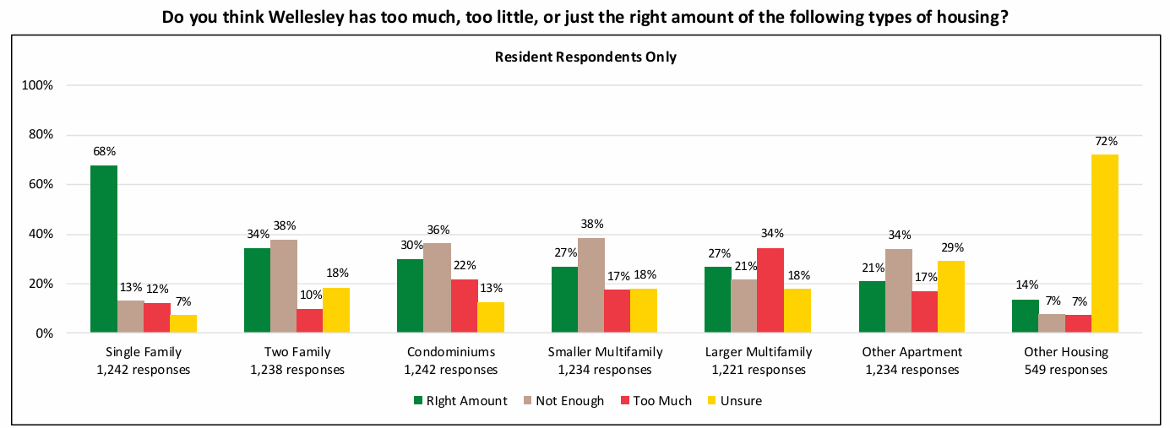
Wellesley Strategic Housing Plan Survey Statistics
Do you think Wellesley has too much, too little, or just the right amount of the following types of housing?
Emphatically, Wellesley wants to stay predominantly Single Family
Right Amount
Not Enough
Too Much
Unsure

Slide 9
Wellesley Strategic Housing Plan Survey Statistics
Do you think Wellesley has too much, too little, or just the right amount of the following types of housing?
But at the same time, citizens seem amenable to other multi-housing options
Right Amount
Not Enough
Too Much
Unsure

Slide 10
Wellesley Strategic Housing Plan Survey Statistics
Do you think Wellesley has too much, too little, or just the right amount of the following types of housing?
And Wellesley is not convinced about larger housing projects
Right Amount
Not Enough
Too Much
Unsure

Slide 11
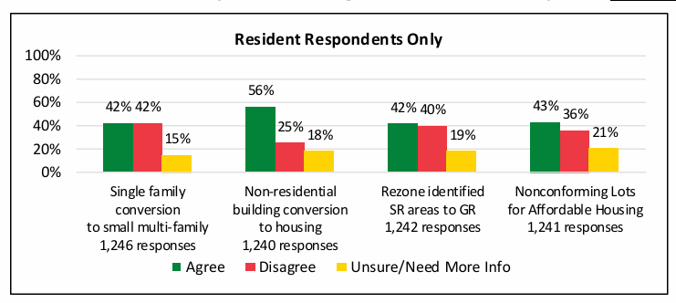
Wellesley Strategic Housing Plan Survey Statistics
Indicate your level of agreement with these specific zoning strategies that could support housing choice in Wellesley.
Citizens are very comfortable converting non-residential buildings to housing, but less sure on other {small} zoning strategies.

Slide 12
Terms and Definitions
Affordable Housing – Housing deemed economically feasible for a certain level of income as compared the H.U.D. average for (in our case) the Boston metro area
  80% of AMI
    the standard of affordability used in the MA 40B law, and the upper range of affordability to be met by builders in Wellesley through inclusionary zoning
    AMI stats for 2025: 80% AMI = $105,850 for a family of 2, $132,300 for a family of 4
  140% of AMI (also called “Workforce Housing”)
    The upper range defined for one quarter of affordable units built via inclusionary zoning
    For 2025, 140% AMI = $185,360 for a family of 2, $231,560 for a family of 4
Multi-Unit Housing – Any housing where more than 2 housing units (not counting ADUs) exist on a land parcel.
  Can be a duplex of 2 units (there are xxx in Wellesley) or a single building of 350 units (the Nines).

